Slide 1
Unit Test Vue.js with Karma & Mocha
by WANZARGEN

Slide 2
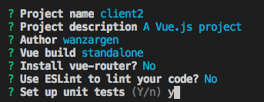

Vue CLI를 이용한 세팅

Slide 3
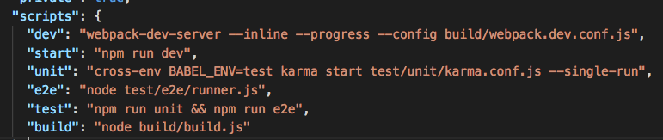

Run unit test
package.json

Slide 4
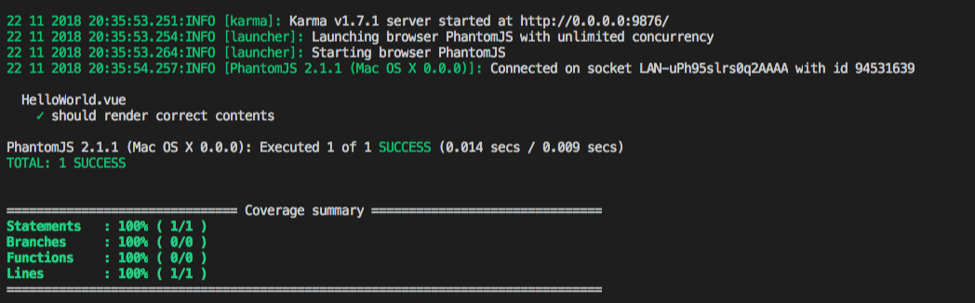
Unit Test Result

Slide 5
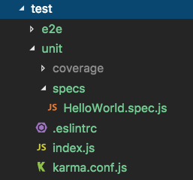
Test folder structure

Slide 6
karma.conf.js
var webpackConfig = require('../../build/webpack.test.conf')
module.exports = function karmaConfig (config) {
config.set({
browsers: ['PhantomJS'],
frameworks: ['mocha', 'sinon-chai', 'phantomjs-shim'],
reporters: ['spec', 'coverage'],
files: ['./index.js'],
preprocessors: {
'./index.js': ['webpack', 'sourcemap']
},
webpack: webpackConfig,
webpackMiddleware: {
noInfo: true
},
coverageReporter: {
dir: './coverage',
reporters: [
{ type: 'lcov', subdir: '.' },
{ type: 'text-summary' }
]
}
})
}

Slide 7
index.js
import Vue from 'vue'
Vue.config.productionTip = false
// require all test files (files that ends with .spec.js)
const testsContext = require.context('./specs', true, /\.spec$/)
testsContext.keys().forEach(testsContext)
// require all src files except main.js for coverage.
// you can also change this to match only the subset of files that
// you want coverage for.
const srcContext = require.context('../../src', true, /^\.\/(?!main(\.js)?$)/)
srcContext.keys().forEach(srcContext)

Slide 8
HelloWorld.spec.js
import Vue from 'vue'
import HelloWorld from '@/components/HelloWorld'
describe('HelloWorld.vue', () => {
it('should render correct contents', () => {
const Constructor = Vue.extend(HelloWorld)
const vm = new Constructor().$mount()
expect(vm.$el.querySelector('.hello h1').textContent)
.to.equal('Welcome to Your Vue.js App')
})
})

Slide 9
Specs in Jasmine
A spec contains one or more expectations that test the state of the code.
An expectation in Jasmine is an assertion that is either true or false.
A spec with all true expectations is a passing spec.
A spec with one or more false expectations is a failing spec.

Slide 10
Grammar
Since describe and it blocks are functions, they can contain any executable code necessary to implement the test.
JavaScript scoping rules apply, so variables declared in a describe are available to any it block inside the suite.
describe('HelloWorld.vue', () => {
it('should render correct contents', () => {
...
})
})

Slide 11
Grammar
Expectation 문은 실제값을 취하는 expect 함수로 작성
기대 값(예상 값)을 가지는 Matcher function 들과 연결됨(chained)
각 ’matcher’들은 실제 값과 예상 값을 비교 -> report boolean 값 to Jasmine
var a = 12;
expect(a).toEqual(12);
expect(true).toBe(true);
expect(false).not.toBe(true);
var message = "foo bar baz";
expect(message).toMatch(/bar/);
expect(message).toMatch("bar"); expect(message).not.toMatch(/quux/);
Jasmine grammar =>

Slide 12
Grammar
HelloWorld.vue
HelloWorld.spec.js
<template>
<div class="hello">
<h1>{{ msg }}</h1>
</div>
</template>
<script>
export default {
name: 'HelloWorld',
data () {
return {
msg: 'Welcome to Your Vue.js App'
}
}
}
</script>
<style scoped> </style>
const Constructor = Vue.extend(HelloWorld)
// Vue를 상속받는 하위 클래스를 만듦
const vm = new Constructor().$mount()
//인스턴스를 만들고, 엘리먼트에 마운트함
expect(vm.$el.querySelector('.hello h1')
.textContent)
.to.equal('Welcome to Your Vue.js App')
Notes:
Vue 인스턴스가 인스턴스화 할 때 el 옵션이 없으면 연결된 DOM 엘리먼트 없이 “unmounted” 상태가 됩니다. vm.$mount()는 unmounted 된 Vue인스턴스의 마운트를 수동으로 시작하는데 사용
인스턴스가 마운트 된 이후, 그 엘리먼트는 vm.$el로 액세스 가능
*mount: adding nodes to the DOM
*unmount: removing them from the DOM
*updating: making changes to nodes already in the DOM

